Slide 1
Land lunar using DQN
Reinforcement learning project
Amirhosein Salimi

Slide 2
DQN (Deep Q Network)
DQN stands for Deep Q-Network, and it is a reinforcement learning algorithm developed by DeepMind in 2013. It combines deep learning techniques with Q-learning, a classic reinforcement learning algorithm.
DQN is considered a reinforcement learning algorithm because it operates in an environment where an agent learns to take actions in order to maximize some notion of cumulative reward.

Slide 3
The key components and characteristics of DQN include:
Q-learning
Deep learning
Experience replay
Target network

Slide 4
Q-learning
DQN is based on Q-learning, a classic reinforcement learning algorithm that learns to approximate the optimal action-value function (Q-function). The Q-function represents the expected cumulative reward for taking a particular action in a given state and following an optimal policy thereafter.

Slide 5
Deep Learning
DQN utilizes a deep neural network, typically a convolutional neural network (CNN), as a function approximator to estimate the Q-values (action-values) for different actions directly from raw sensory inputs

Slide 6
Experience Replay
DQN employs an experience replay buffer to store transitions (state, action, reward, next state) encountered during exploration. This buffer enables the algorithm to learn from past experiences by sampling random batches of transitions, thereby breaking temporal correlations in the data and improving sample efficiency.

Slide 7
Target Network
To stabilize training and prevent harmful correlations, DQN introduces a target network, which is a separate copy of the Q-network used to generate target Q-values during training. The parameters of the target network are periodically updated to match those of the Q-network.

Slide 8
Epsilon-Greedy Exploration
DQN follows an epsilon-greedy policy to balance exploration and exploitation. With probability epsilon, the agent selects a random action (exploration), and with probability 1-epsilon, it selects the action with the highest Q-value according to the current Q-network (exploitation).

Slide 9
Loss Function
During training, DQN minimizes the mean squared TD (temporal difference) error between the predicted Q-values and the target Q-values, which are calculated using the Bellman equation. The loss function quantifies the discrepancy between the predicted and target Q-values and guides the learning process.

Slide 10
Classes used in the code
Memory
Nueral_network
Dqn

Slide 11
Memory Class
The memory class is a crucial component of the Land Lunar project, responsible for managing the agent's experience replay buffer. Experience replay is a fundamental technique used in reinforcement learning algorithms to improve sample efficiency and stabilize training by storing and replaying past experiences.

Slide 12
Memory Class - methods
push(*args): Saves a transition into the memory buffer.
sample(batch_size): Randomly samples a batch of transitions from the memory buffer.
__len__(): Returns the current size of the memory buffer.

Slide 13
Memory class …
The memory class utilizes Python's deque data structure to efficiently store transitions while limiting the buffer's capacity. This implementation ensures that older transitions are automatically removed when the buffer reaches its maximum capacity, maintaining a fixed-size replay memory for the agent's training.

Slide 14
Neural Network Class
The neural_network class defines a customizable feedforward neural network architecture using PyTorch's nn.Module framework. This class serves as the backbone for constructing neural network models used in the Land Lunar project.

Slide 15
Neural Network Class - Parameters
layers: A list specifying the number of neurons in each layer of the neural network. The first element represents the input size, and the last element represents the output size.
dropout: A boolean indicating whether dropout regularization should be applied to the network. Dropout randomly drops out neurons during training to prevent overfitting.
p_dropout: The probability of dropping out neurons if dropout is enabled.

Slide 16
Neural Network Class - methods
forward(x): Defines the forward pass of the neural network. It iterates through the network layers sequentially and applies them to the input x.

Slide 17
Deep Q-Network (DQN) Class
The dqn class implements a Deep Q-Network (DQN) reinforcement learning algorithm. It is designed to learn to play the Lunar Lander game.

Slide 18
Dqn Class - methods
__init__(self, parameters): Initializes the DQN agent with specified parameters.
train(self, environment, verbose=True): Trains the DQN agent using the specified environment.
make_dictionary_keys_lowercase(self, dictionary): Converts dictionary keys to lowercase.

Slide 19
Dqn Class - methods
merge_dictionaries(self, dict1, dict2): Merges two dictionaries.
set_parameters(self, parameters): Sets DQN parameters.
add_memory(self, memory): Adds a transition to the replay memory.
act(self, state, epsilon=0.): Chooses an action based on the current state using an epsilon-greedy policy.

Slide 20
Dqn Class - methods
run_optimization_step(self, epoch): Performs a single optimization step using the DQN algorithm.
soft_update_target_net(self): Performs a soft update of the target network.
evaluate_stopping_criterion(self, list_of_returns): Evaluates the stopping criterion for training.
get_samples_from_memory(self): Retrieves samples from the replay memory.

Slide 21
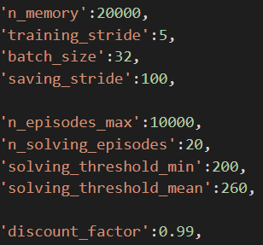
These parameters are key settings that control various aspects of the Deep Q-Network (DQN) algorithm and its training process. Let's go through each parameter and discuss how they can influence the algorithm's behavior and training outcomes:

Slide 22
n_memory
This parameter specifies the size of the replay memory buffer used in the DQN algorithm. Replay memory stores experiences (state, action, next state, reward, done) for training the neural network.
A larger n_memory allows the DQN algorithm to store more experiences, potentially leading to better sample efficiency and more stable training. However, it also increases memory consumption.

Slide 23
training_stride
This parameter determines the frequency (in terms of environment steps) at which the DQN algorithm performs optimization steps (updates the neural network weights) using experiences sampled from the replay memory.
A smaller training_stride means more frequent updates, which can lead to faster learning but may also introduce more instability in training due to highly correlated updates.

Slide 24
batch_size
This parameter specifies the number of experiences sampled from the replay memory for each optimization step (mini-batch size) during training.
A larger batch_size allows the neural network to learn from more diverse experiences in each optimization step, potentially leading to more stable training. However, it also increases computational overhead and memory usage.

Slide 25
saving_stride
This parameter determines the frequency (in terms of episodes) at which the DQN algorithm saves the model or training progress (e.g., model weights, training statistics) to disk.
A smaller saving_stride means more frequent saves, which can be useful for monitoring training progress and resuming training from checkpoints. However, it may also increase disk I/O overhead.

Slide 26
n_solving_episodes
This parameter determines the number of recent episodes used to evaluate the stopping criterion during training.
A larger n_solving_episodes considers a longer history of episode returns for evaluating whether the training has reached a satisfactory performance level. However, it may delay the detection of training convergence.

Slide 27
solving_threshold_min
This parameter sets the minimum episode return threshold used in the stopping criterion evaluation.
If the minimum episode return exceeds solving_threshold_min for the specified number of episodes (n_solving_episodes), the training is considered successful.
Adjusting this threshold affects the desired minimum level of performance required for the DQN algorithm to solve the task

Slide 28
solving_threshold_mean
This parameter sets the mean episode return threshold used in the stopping criterion evaluation.
Similar to solving_threshold_min, but it considers the mean episode return over the specified number of episodes (n_solving_episodes).
It influences the desired average performance level of the DQN algorithm.

Slide 29
discount_factor
Also known as gamma, this parameter determines the importance of future rewards in the Q-value estimation.
A higher discount_factor values give more weight to future rewards, encouraging the agent to prioritize long-term rewards. Conversely, lower values make the agent focus more on immediate rewards

Slide 30
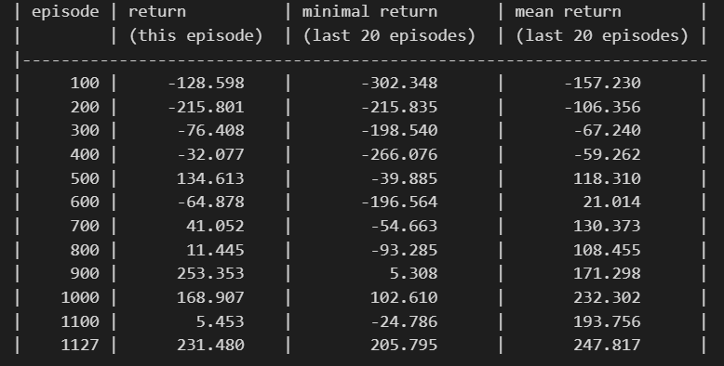
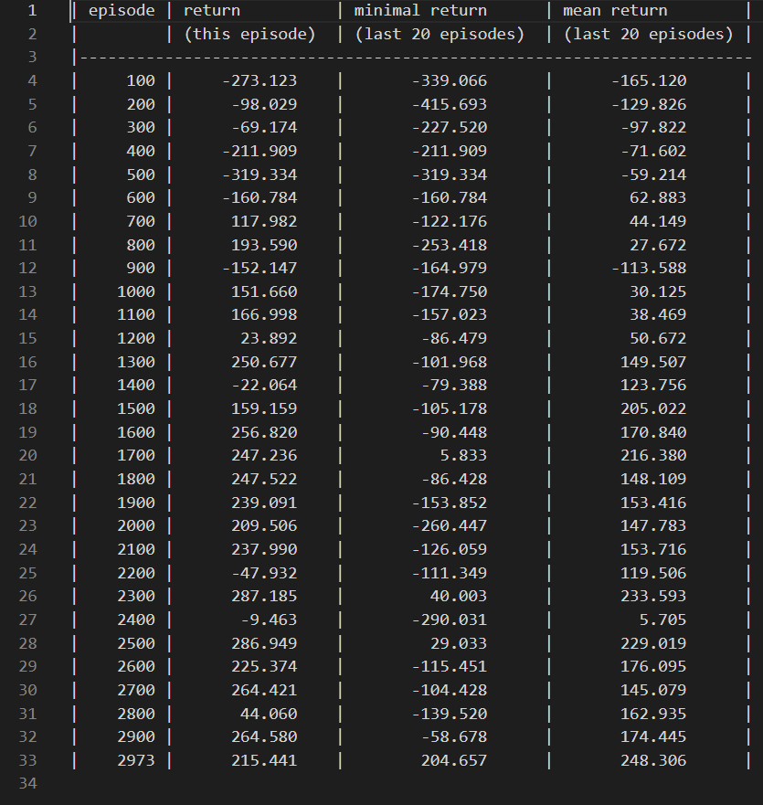
N_memory
N_memory = 30000
With a larger replay memory buffer (n_memory = 30,000), the DQN algorithm can store a more diverse set of experiences from interactions with the environment. This diversity in experience sampling may lead to more effective learning
N_memory = 100

Slide 31
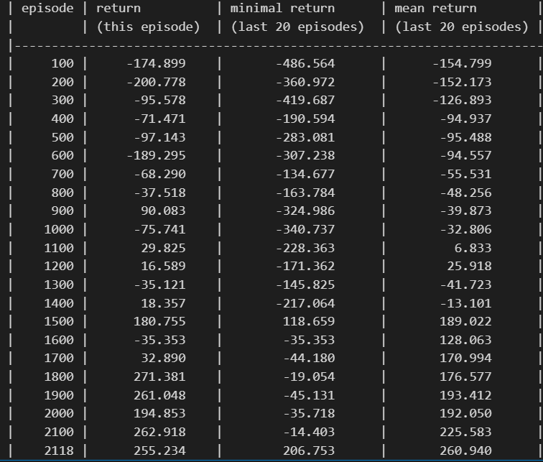
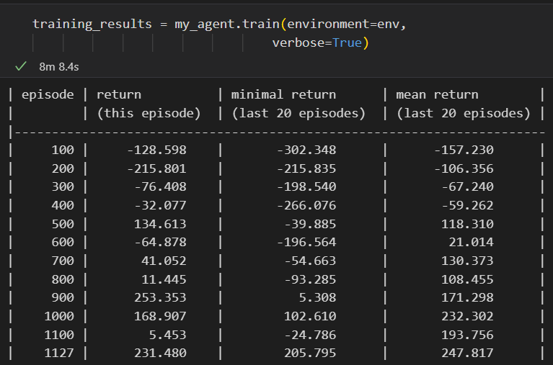
training_stride
More frequent updates can lead to faster learning and adaptation to changes in the environment.
training_stride = 15
training_stride = 5

Slide 32
Batch_ size
increasing the batch size in training a neural network can lead to faster convergence, improved resource utilization, and reduced variance in gradient estimates

Slide 33
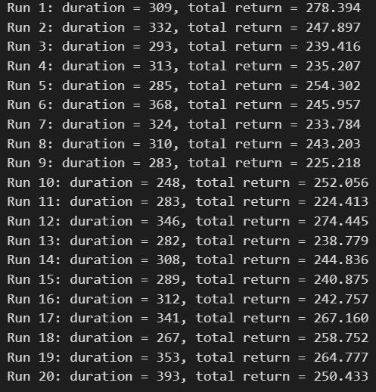
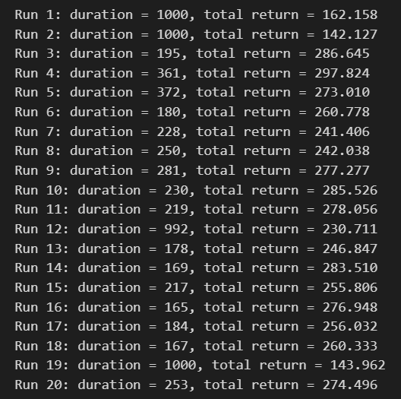
challange
Insufficient Exploration: A high threshold may lead the agent to focus more on exploiting known strategies rather than exploring new ones. This can prevent the agent from discovering potentially better policies that could lead to higher returns.
Duration 1000
Choosing lower value for mean treshold
Mean_treshold = 270
Mean_treshold = 230

Slide 34
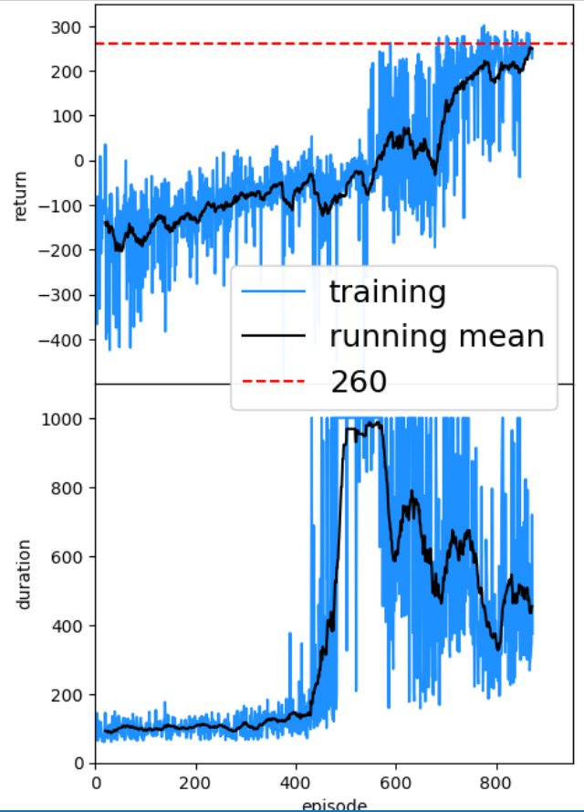
Example of reward , duration per episode

